Slide 1



Journey to Spaceport
Charlie Nitschelm
University of New Hampshire
Students for the Exploration and Development of Space

Slide 2
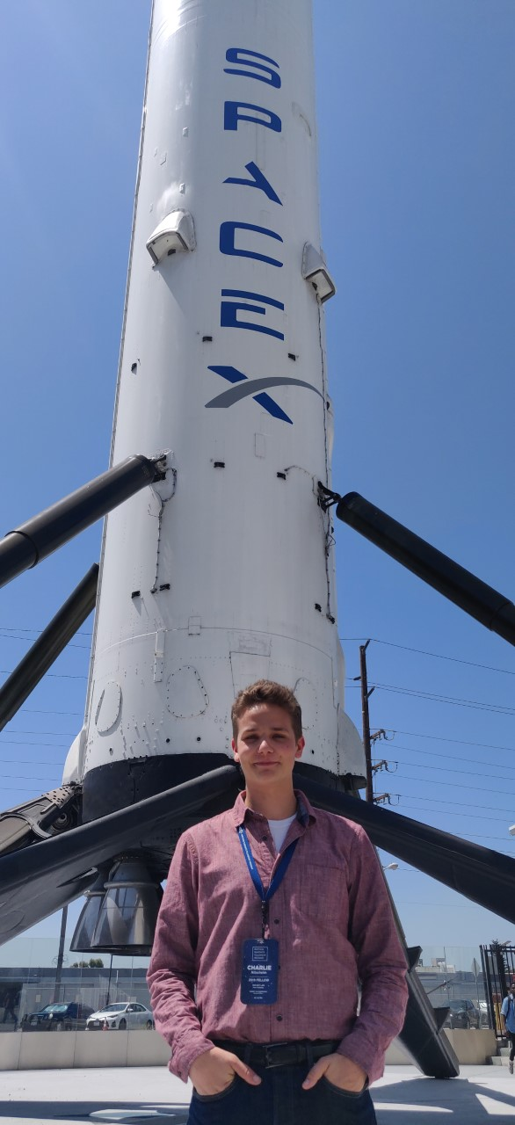
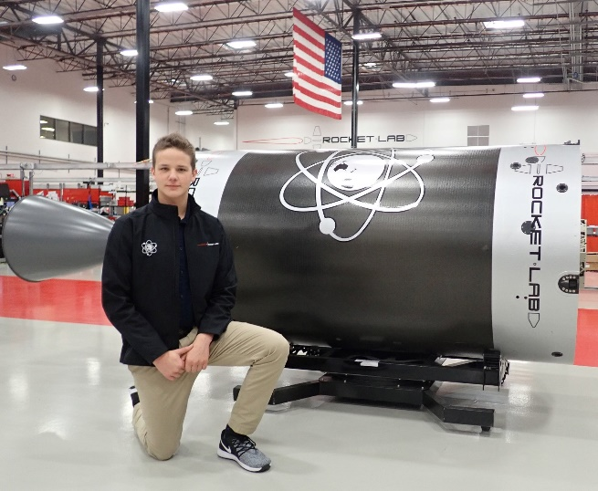
My Background
Senior mechanical engineering major and physics minor at the University of New Hampshire
Founded UNH SEDS at the end of my freshman year and am the current President and Lead Engineer
Elected to the board of SEDS USA, the largest student-run space organization, as the Member at Large
Job Experiences ___
Summer 2018
Researcher at NIST on the mechanical behavior of Inconel in extreme conditions ___
2018-2019 School Year
Manufacturing engineering intern at TURBOCAM international focused on the affect tool coatings have on the lifetime of a tool ___
Summer 2019
Propulsion manufacturing intern at Rocket Lab USA focused on process improvement within printing, machining and welding
University of New Hampshire
Students for the Exploration and Development of Space

Slide 3
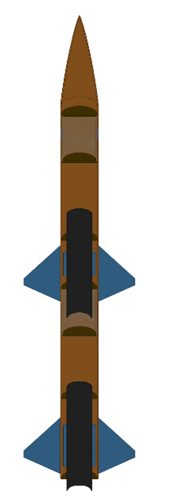



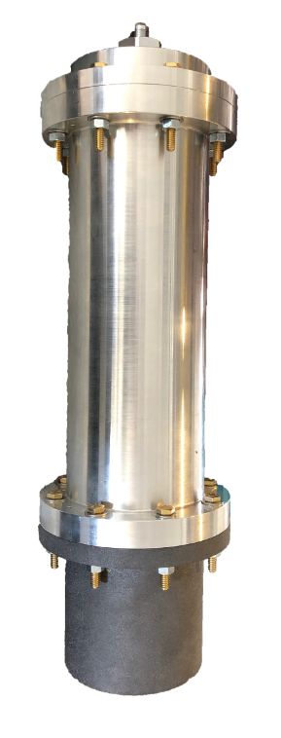
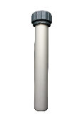
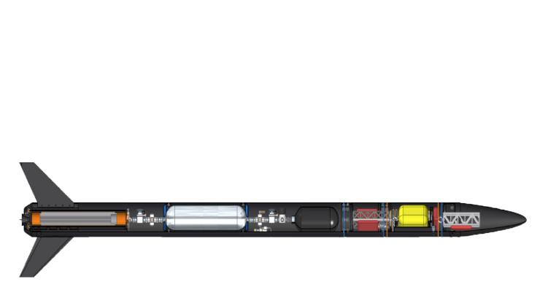

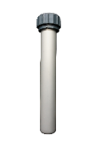
The 3-Year Plan
Year One
2017-2018
Year Two
2018-2019
Year Three
2019-2020
Runaway
Rocket Building
Simulating
Launching
Optimizing
Hybrid Engine
Engine Design
Manufacture
Test
Hybrid Rocket
Spaceport America Cup
Rocket Vehicle
Engine Optimization
University of New Hampshire
Students for the Exploration and Development of Space

Slide 4
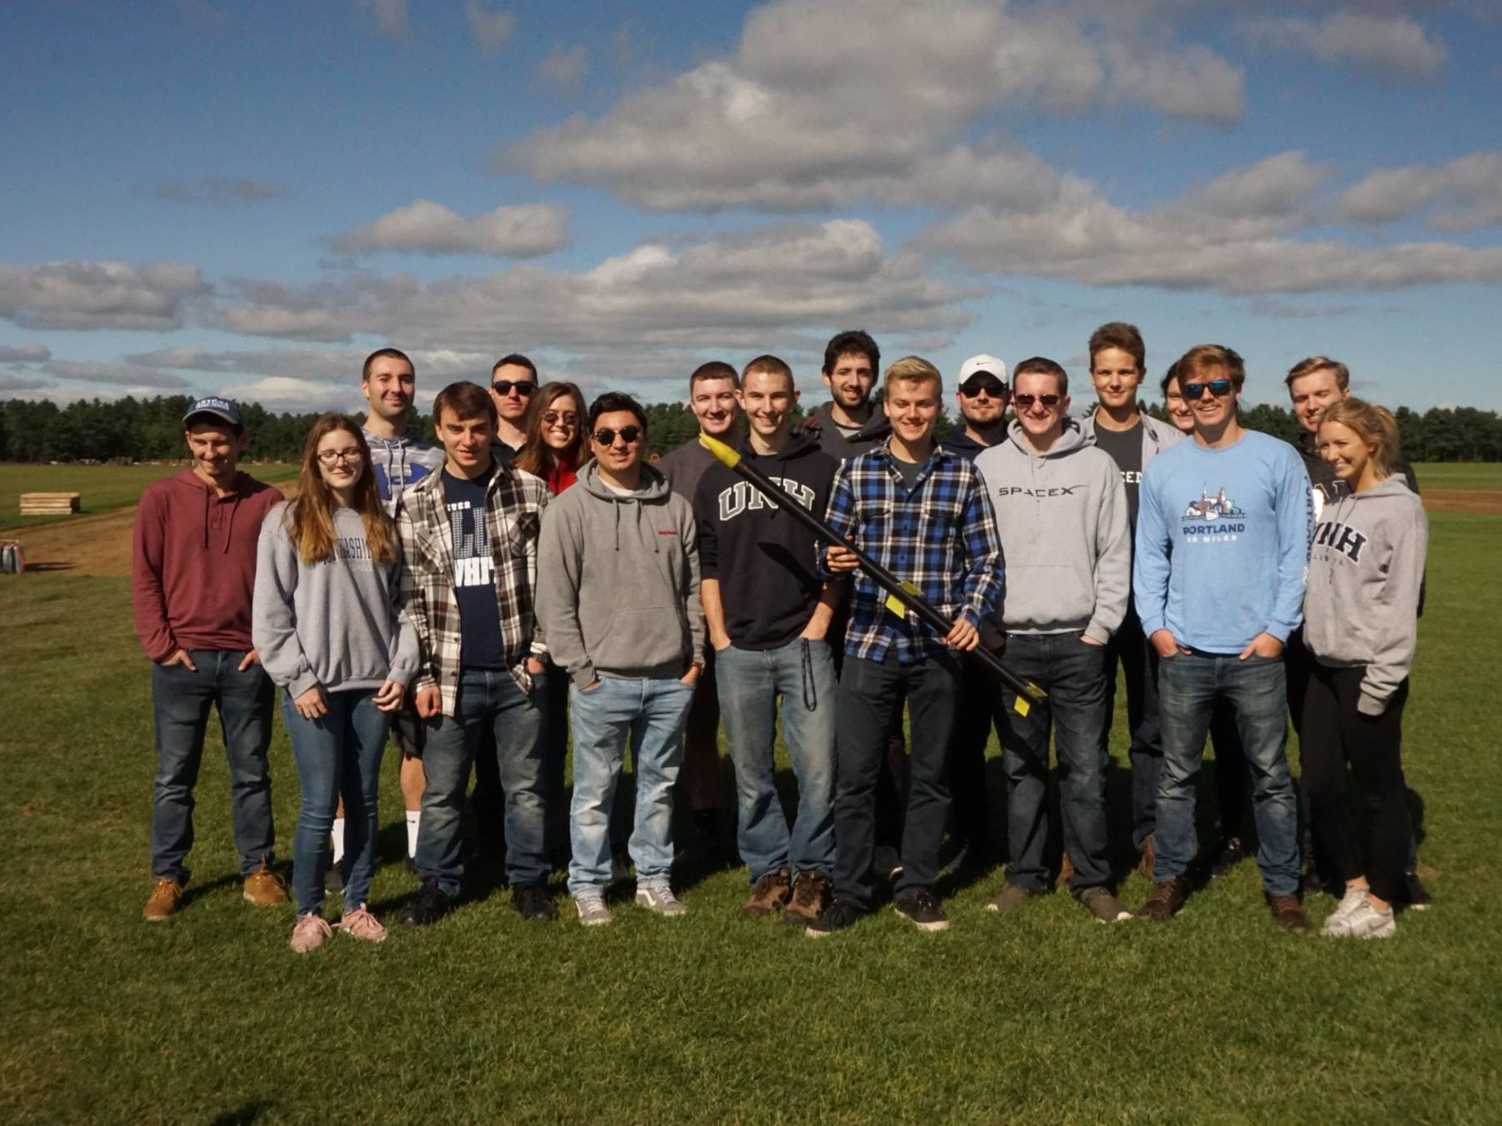
Year 1 – Sophomore Year
Organization Statistics
Committed Members: 14
Majors: 3
Senior Projects: 4
Funding: $2,250
SEDS Rocketry Competition, May 2018, Maine
University of New Hampshire
Students for the Exploration and Development of Space

Slide 5
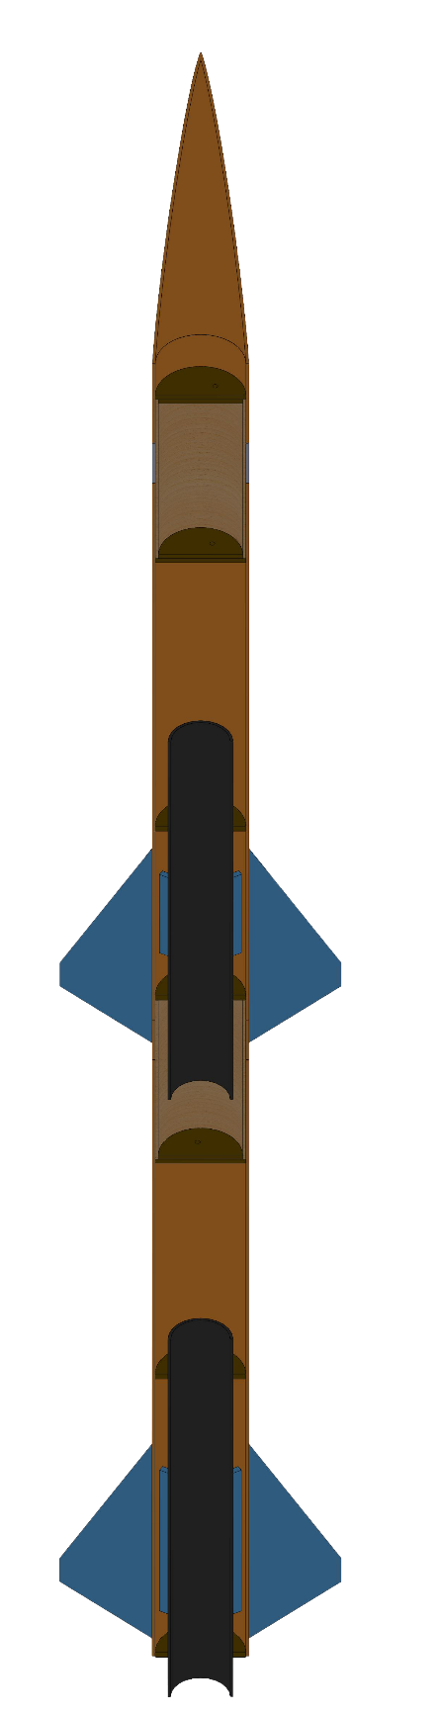
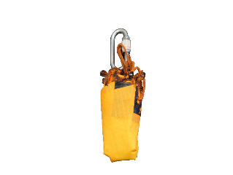
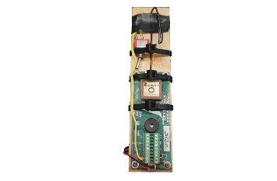
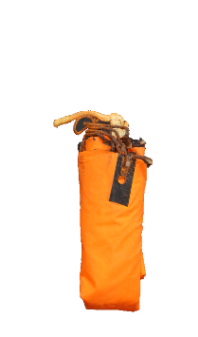
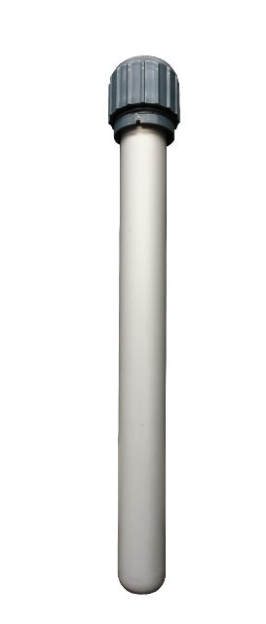


Drogue Parachute
A small parachute deployed at sustainer apogee
Custom Nose Cone
A 3D printed nose cone that houses the drogue parachute and connects directly to the electronics bay
Year 1 – Rocket Building
Electronics Bay
Houses the TeleMega GPS and controls both parachute deployment and sustainer ignition
Sustainer Parachute
A larger main parachute that
slows the sustainer to a safe landing speed
Sustainer Engine
Propels the rocket to max altitude after booster burnout; 1.7 second burn time
Forward Fins
Provides stability to
the sustainer after stage separation
Staging Coupler
Supports stage separation at sustainer ignition
Booster Parachute
A large parachute to slow the
booster to a safe landing speed
University of New Hampshire
Students for the Exploration and Development of Space
Aft Fins
Provides stability to the rocket before stage separation
Booster Engine
Initiates flight with a
0.7 second burn time

Slide 6
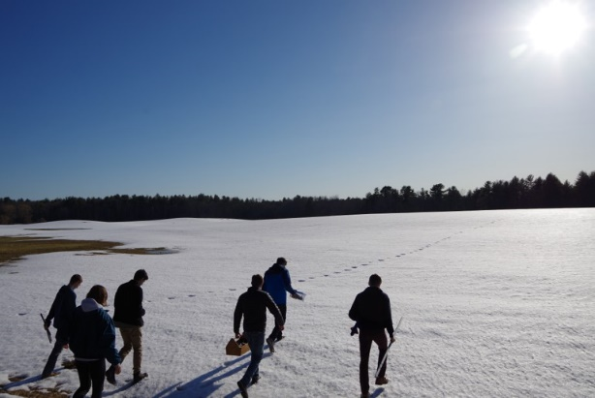
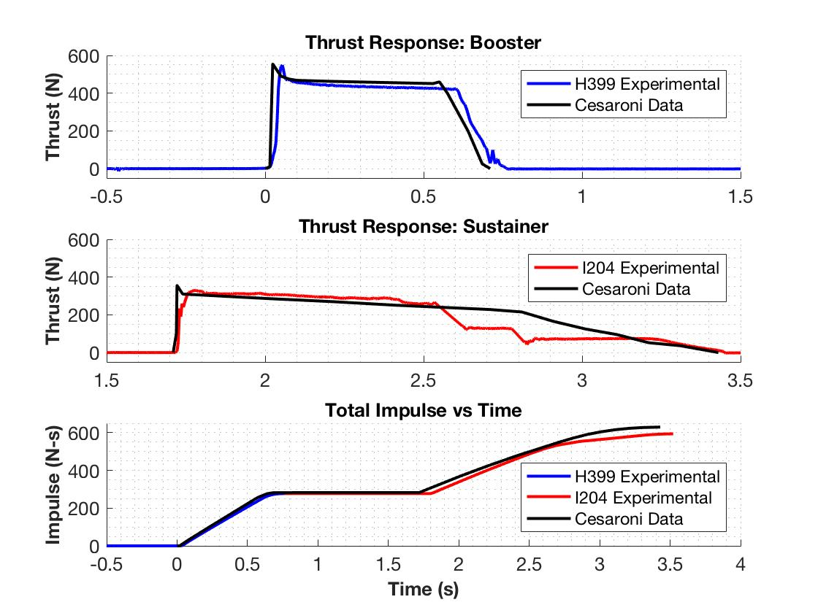
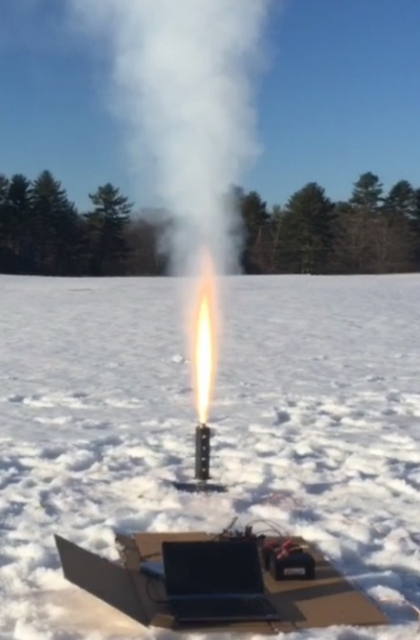
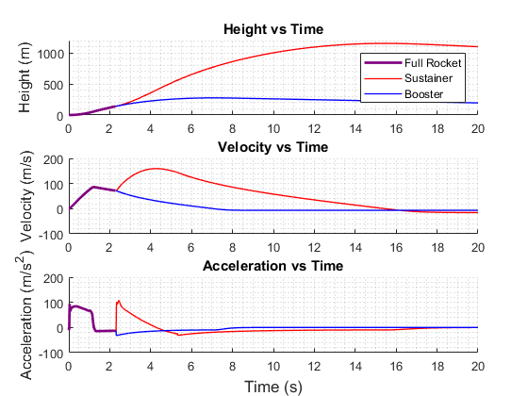
Year 1 – Simulating
 | Reported Max Thrust | Measured Max Thrust | Reported Total Impulse | Measured Total Impulse
Booster Engine: Cesaroni H399 | 545.8 N | 549.6 N | 282.2 N-s | 277.1 N-s
Sustainer Engine: Cesaroni I204 | 356.8 N | 329.7 N | 347.7 N-s | 322.7 N-s
University of New Hampshire
Students for the Exploration and Development of Space

Slide 7
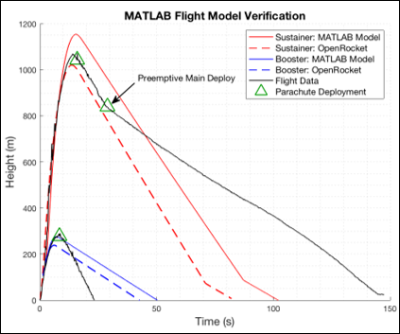

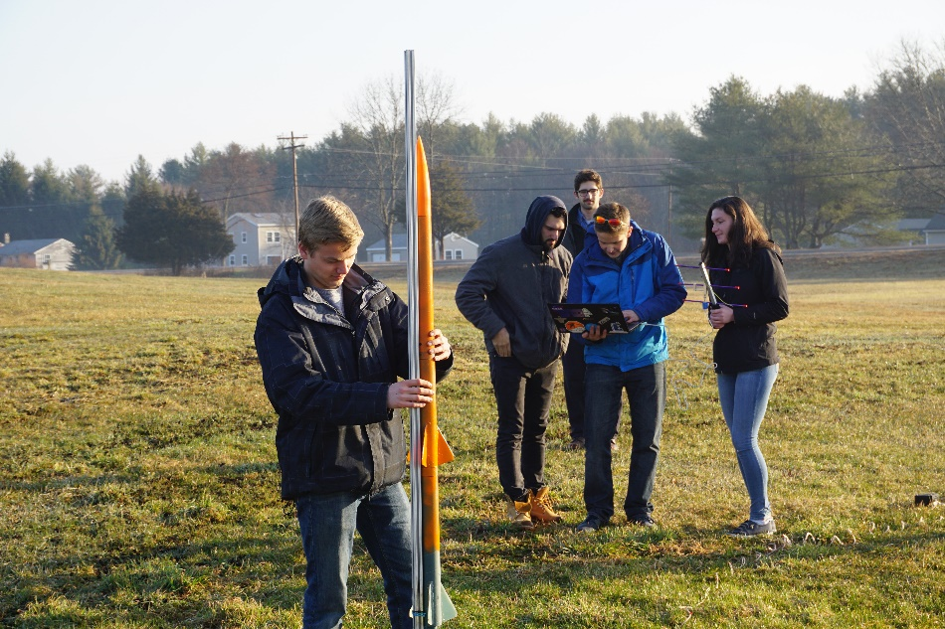
Year 1 – Launching
 | Flight Data | OpenRocket Model | MATLAB Model
Sustainer Apogee | 1071.1 m | 1020.6 m | 1154.1 m
Booster Apogee | 290.0 m | 238.6 m | 276.3 m
University of New Hampshire
Students for the Exploration and Development of Space

Slide 8
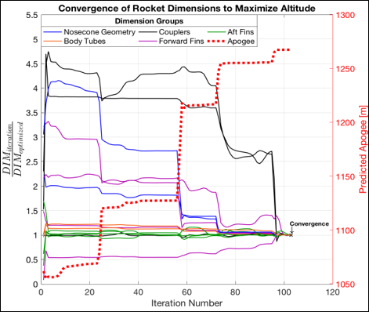
Year 1 – Optimizing and Repeat
Check Integrity with Finite Element Analysis
Research Aerodynamic Theory
Optimize Rocket Dimensions
Improve
Aerodynamic Models
Rocket Improvement Cycle
Manufacture and Assemble
Launch and Gather Data
Improve Manufacturing Techniques
Improve Field Launch Techniques
University of New Hampshire
Students for the Exploration and Development of Space

Slide 9
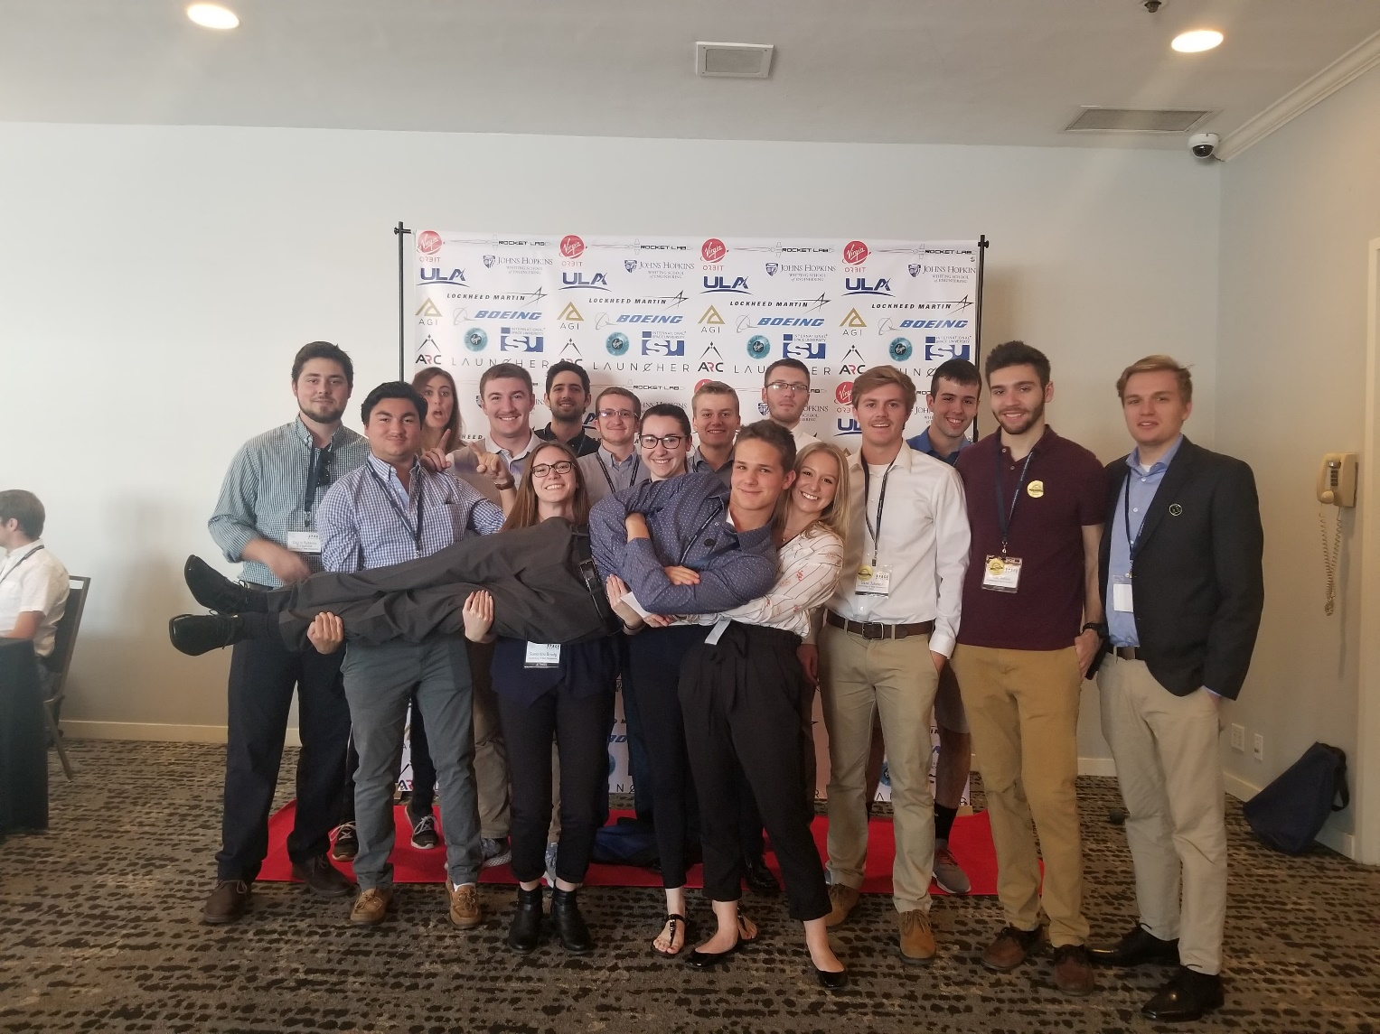
Year 2 – Junior Year
Organization Statistics
Committed Members: 20
Majors: 5
Senior Projects: 9
Funding: $5,500
Spacevision 2018, November 2018, San Diego
University of New Hampshire
Students for the Exploration and Development of Space

Slide 10
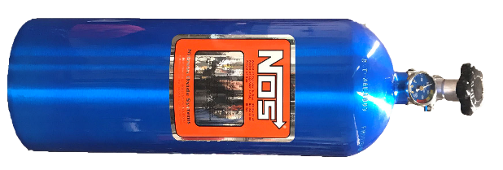
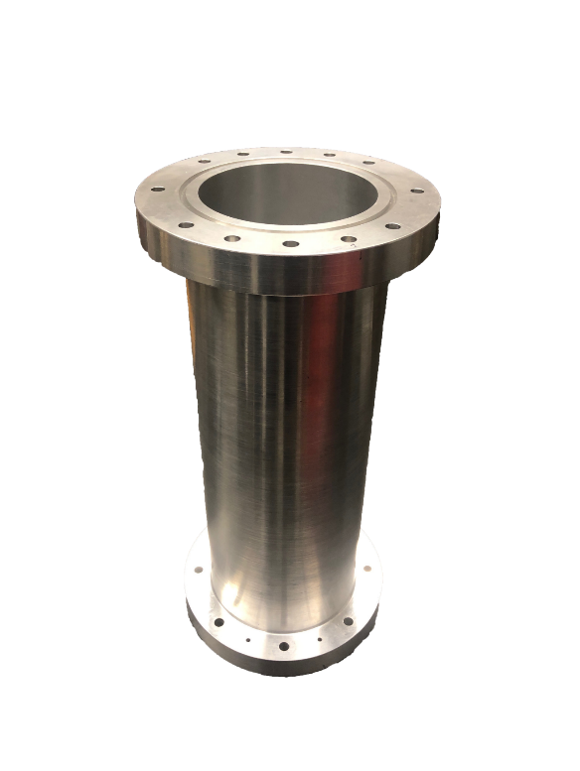
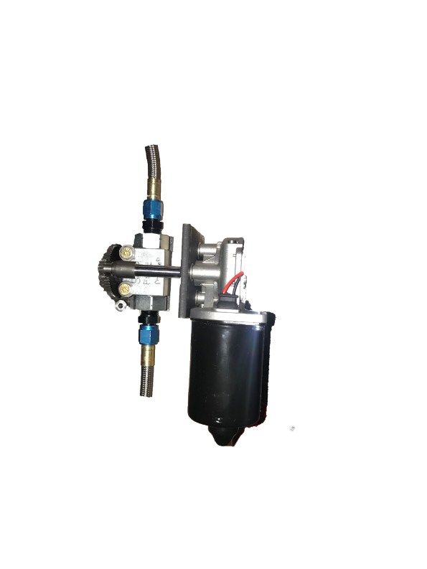
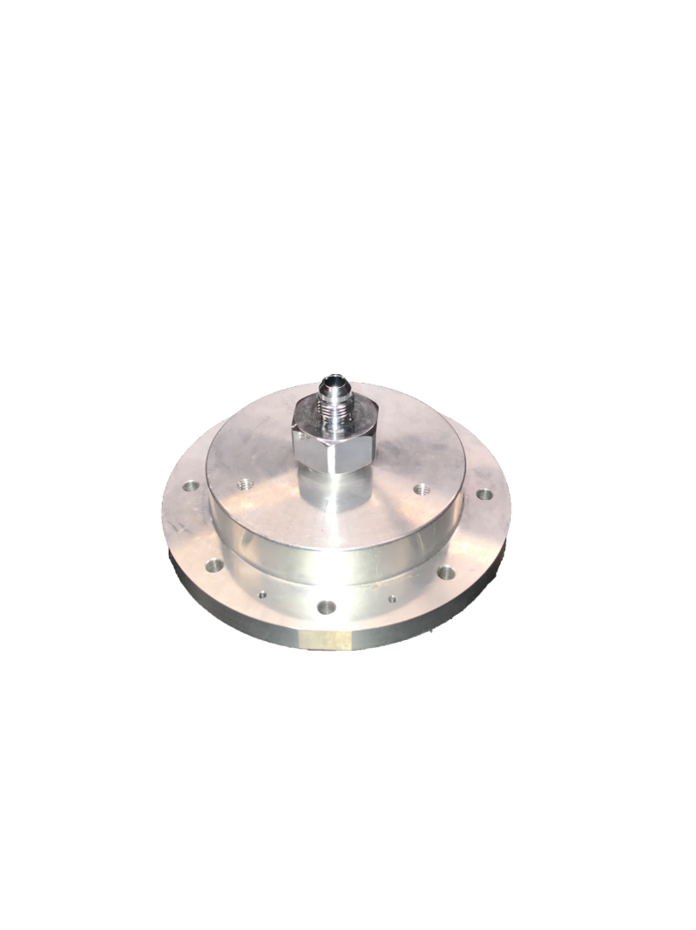
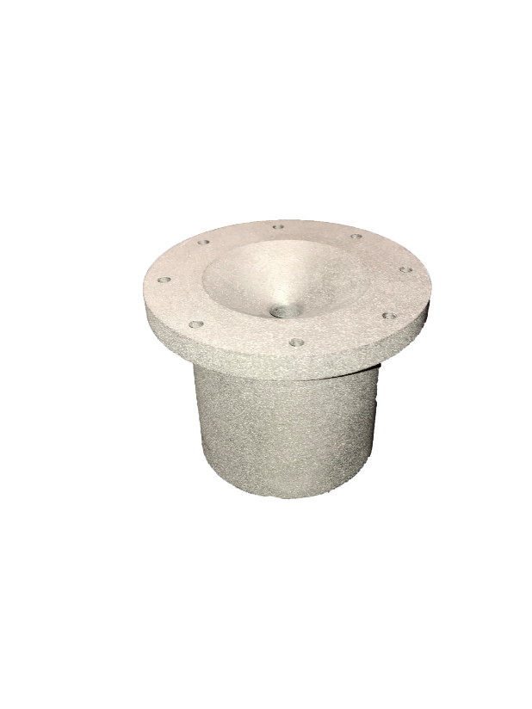
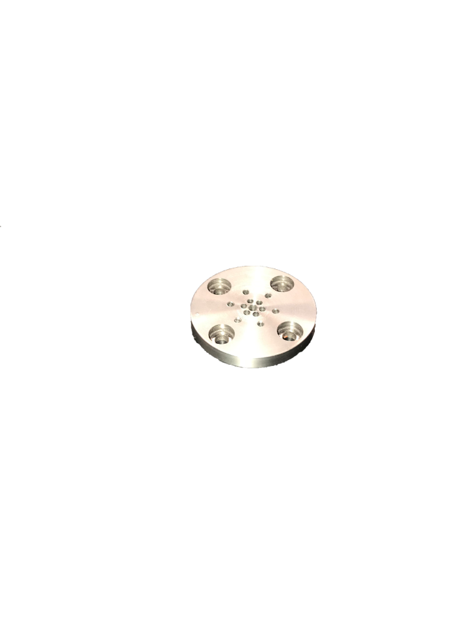

Year 2 – Hybrid Engine Development
Oxidizer Tank
A highly pressurized vessel that contains liquid Nitrous Oxide, acting as our oxidizer within the combustion chamber
Injection Plate
Responsible for providing desired oxidizer flow into the combustion chamber with the assistance of the impinging plate
Combustion Chamber
An enclosed volume where the solid reducer and liquid oxidizer react to produce a superheated, highly pressurized chamber of gas
Flow Regulator
A motorized valve that monitors flow regulation of the oxidizer into the injection plate controlled by an electric motor and an Arduino.
Impinging Plate
An interchangeable cylindrical plate responsible for the impingement and atomization of the oxidizer flow streams
Nozzle
Graphite was machined into a de Laval curve responsible for directing the flow of hot gases outside of the combustion chamber into the environment providing thrust
University of New Hampshire
Students for the Exploration and Development of Space

Slide 11
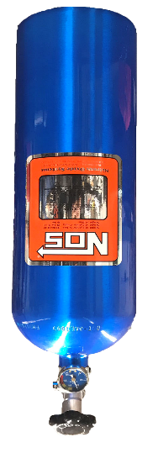
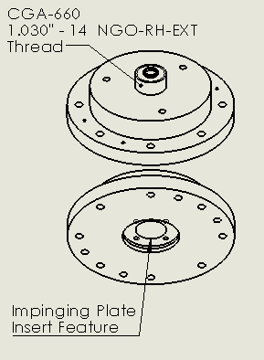
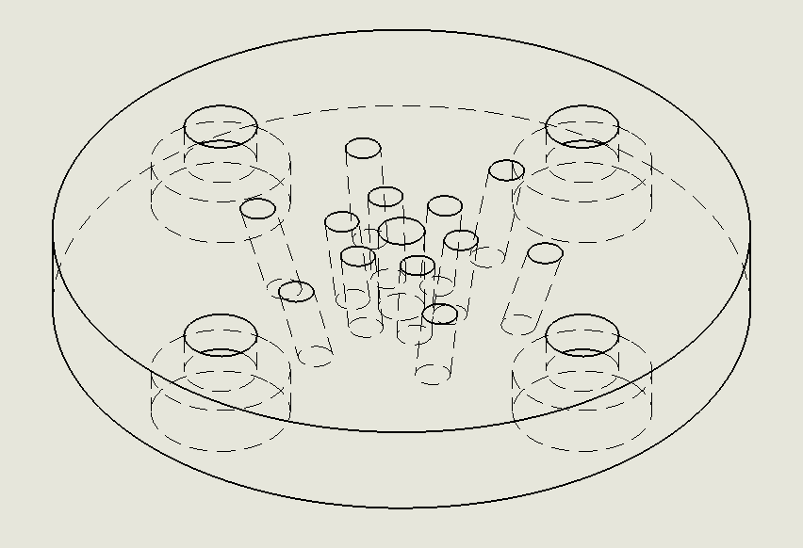
Year 2 – Engine Design
Oxidizer Selection and Flow Regulation
Injector and Impinging Plate
Needs to be self pressurizing
Needs to be safe to handle
Can be refilled within a day
Nitrous Oxide meets these requirements
Interface with COTS piping from flow regulator
Quick testing of different impinging geometries
Transitions the liquid oxidizer to a gas
Suitable for ground testing
Ability to throttle
Cheap
University of New Hampshire
Students for the Exploration and Development of Space

Slide 12
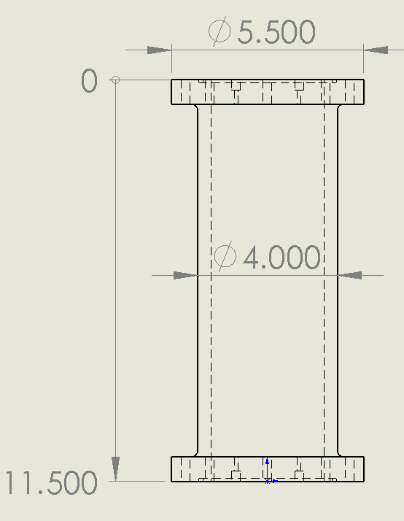
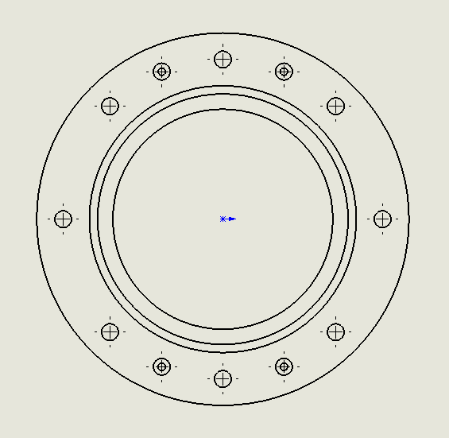
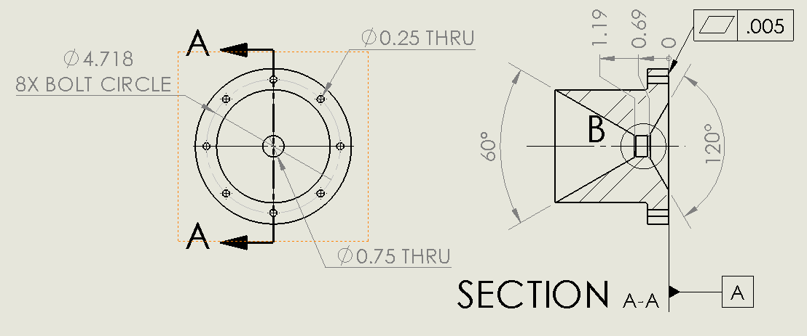
Year 2 – Engine Design
Combustion Chamber
Nozzle
Withstand 400 psi internal pressure
Hold a volume of fuel to support the defined mixture ratio
Seals with the nozzle and injector
Accelerate the hot gases within the combustion chamber using converging/diverging design
Withstand a corrosive, high temperature environment
University of New Hampshire
Students for the Exploration and Development of Space

Slide 13
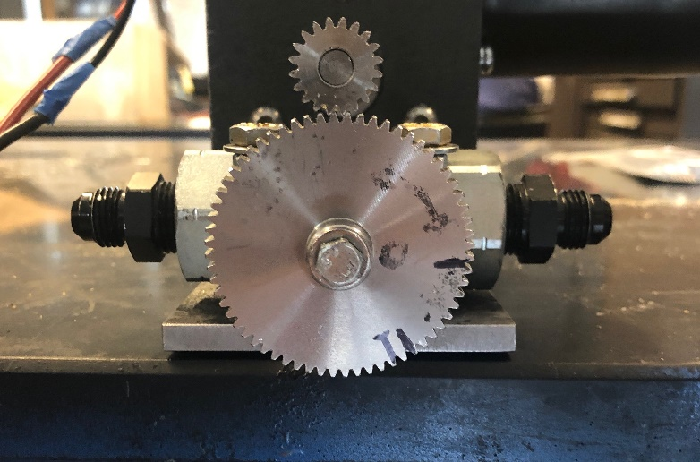
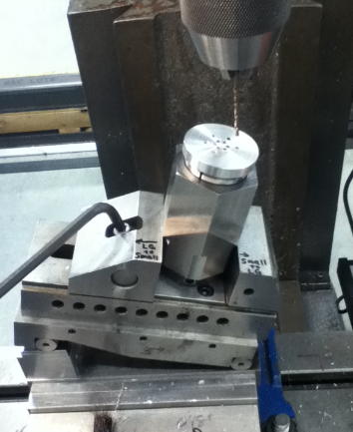
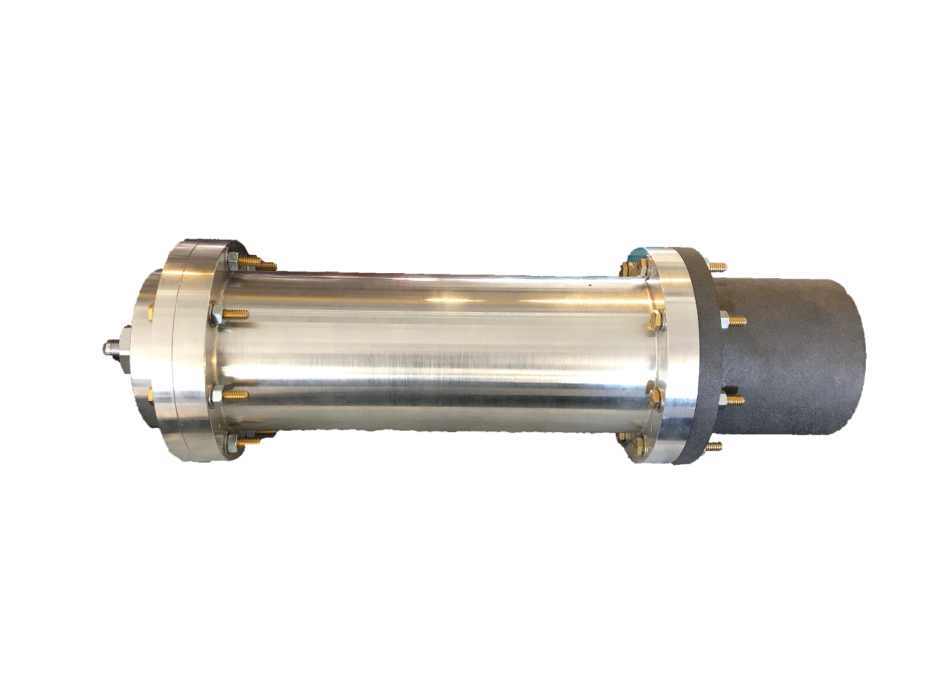
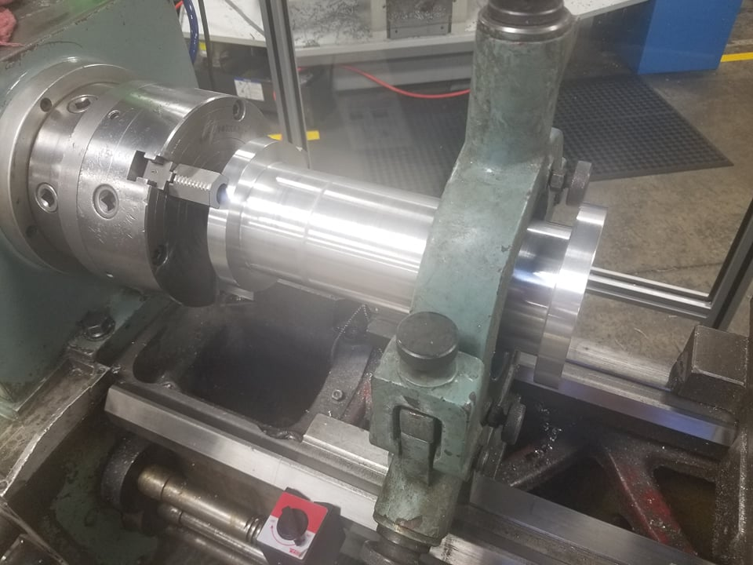
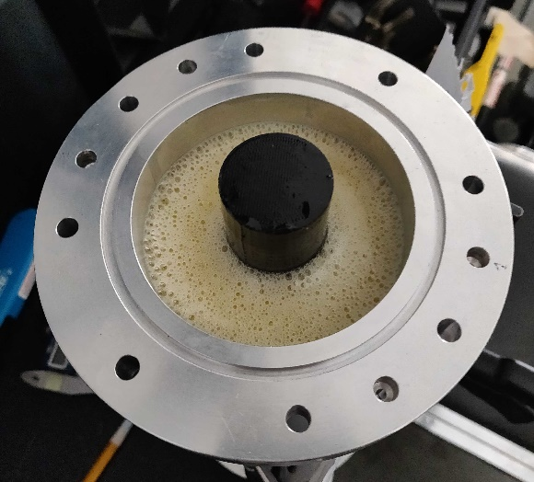
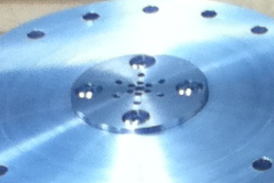
Year 2 – Manufacture
Assembly of the flow regulator
Combustion chamber chucked on the lathe
Runaway fully assembled with the aluminum chamber, injector and graphite nozzle
Machining and assembly of impinging plate
Molding the rubber into the combustion chamber
University of New Hampshire
Students for the Exploration and Development of Space

Slide 14
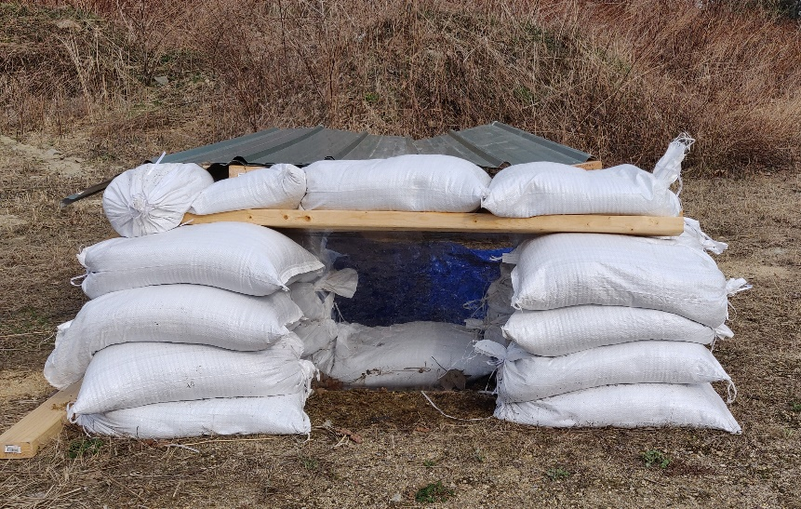
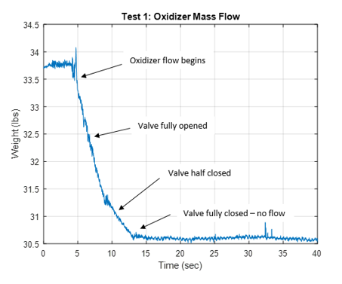
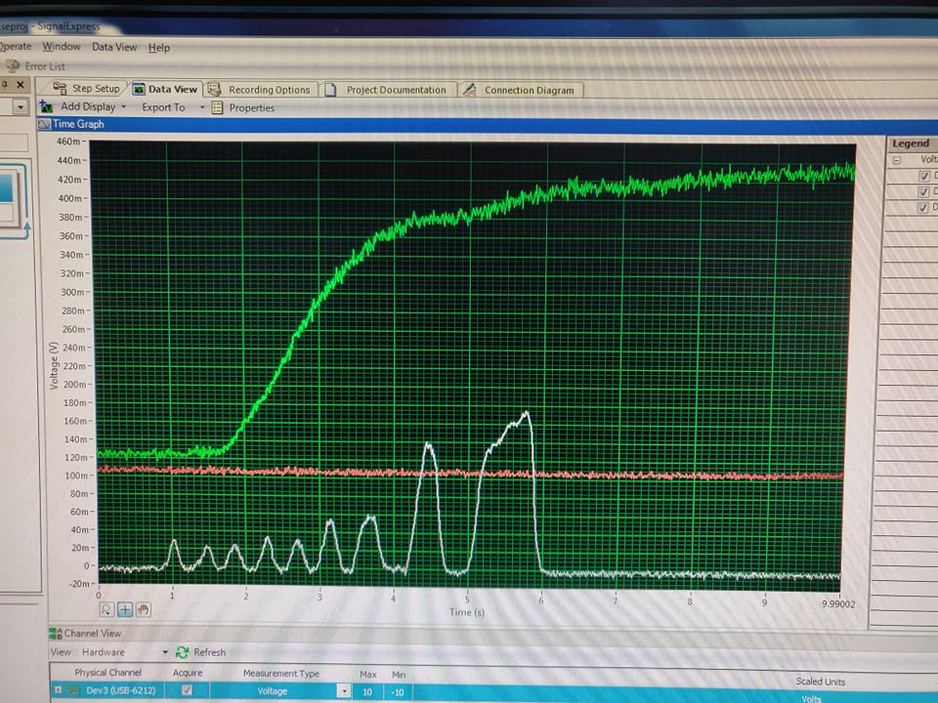
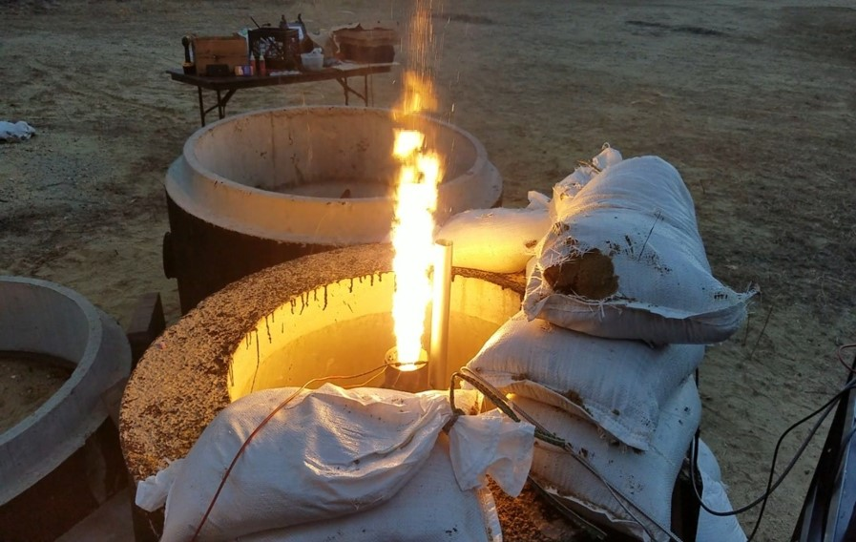
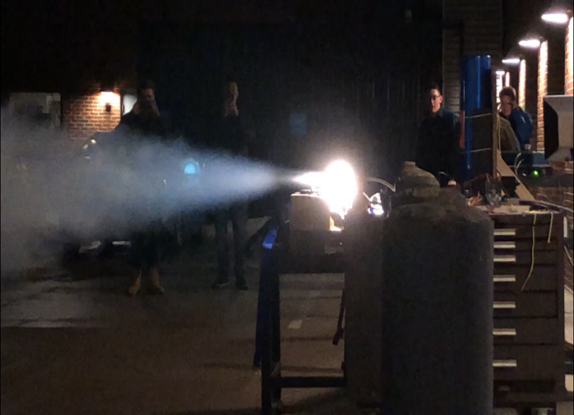
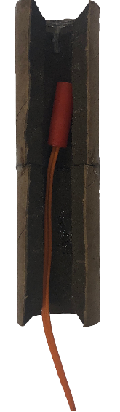
Year 2 – Test
Rapid impinging plate designs tested for impingement and desired flow rate
Electric spark and igniter assembly
Obtain thrust and temperature data during the hot-fire test
Control bunker for hot-fire tests
Hot-fire test 1 – Ignition
University of New Hampshire
Students for the Exploration and Development of Space

Slide 15
Year 3 – Senior Year
Organization Statistics
Committed Members: 42
Majors: 7
Senior Projects: 14
Funding: $9,000 and counting
University of New Hampshire
Students for the Exploration and Development of Space

Slide 16

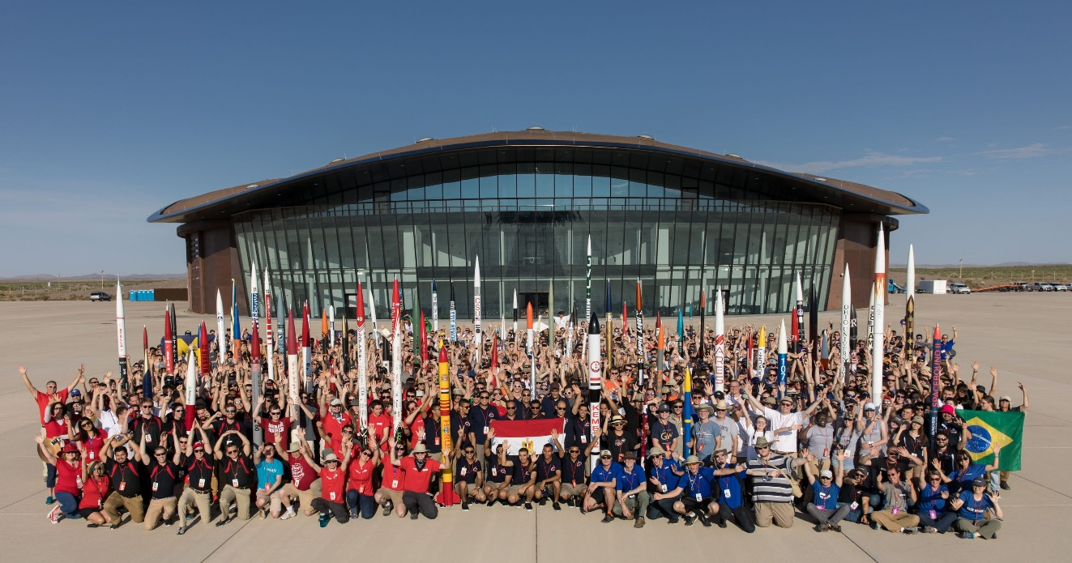
Year 3 – Spaceport Competition
Rocket competition hosted in New Mexico from June 16th to June 20th
Requires teams to launch a rocket using COTS or experimental rocket engines to as close to 10,000/30,000 feet with full recovery
UNH SEDS will be competing in the 10,000-foot experimental hybrid engine category
University of New Hampshire
Students for the Exploration and Development of Space

Slide 17
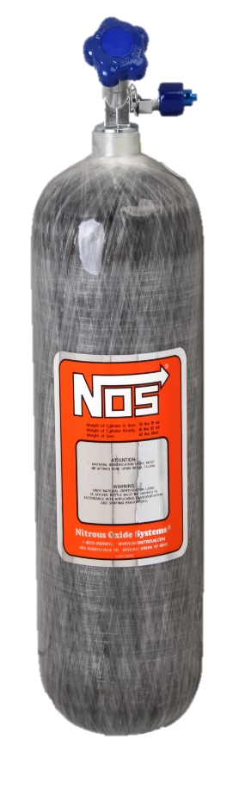
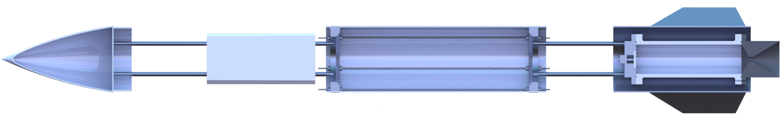

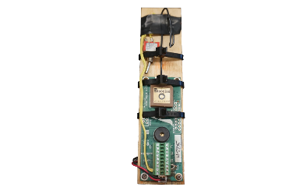
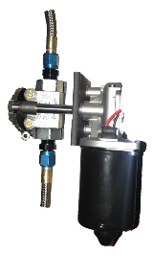
Year 3 – Rocket Vehicle
Avionics
An electronics module responsible for GPS tracking, engine ignition and flow control, real-time data collection, and recovery triggers
Research Payload
A payload built in-house to collect data throughout flight for use in the future
Throttle Control
A flow regulation system to insert oxidizer flow into the combustion chamber to provide thrust to the rocket
Recovery System
A recovery module that is deployed at apogee to land the rocket safely back on Earth
Oxidizer Storage
A pressurized vessel holding the liquid oxidizer to be pumped into the combustion chamber
Runaway
New Hampshire’s first hybrid rocket engine that utilizes a liquid oxidizer and solid fuel to propel its rocket to 10,000 feet
University of New Hampshire
Students for the Exploration and Development of Space

Slide 18
Year 3 – Engine Optimization
Currently the propulsion lead working on optimizing Runaway for integration into the rocket
Team of 9 students in propulsion
University of New Hampshire
Students for the Exploration and Development of Space

Slide 19


Year 3 – Project Management
Chicken suit
University of New Hampshire
Students for the Exploration and Development of Space

